Slide 1

A Clear Gospel
5 steps:
Romans 1:16 For I am not ashamed of the gospel of Christ, for it is the power of God to salvation for everyone who believes,
Power in the gospel
Why be so clear on the gospel? So we don’t make false converts!
2 things it takes to be saved- Repent & believe
1. Creator
2. Conviction
3. Repent
4. Believe
5. Accept

Slide 2


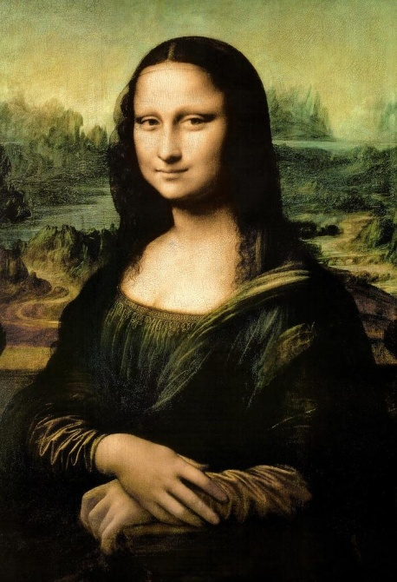
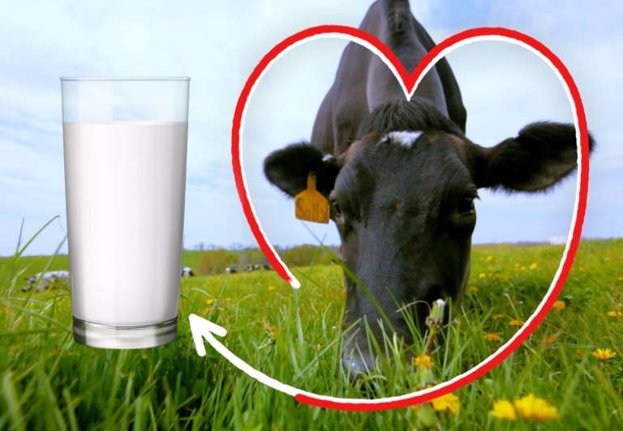

1. Creator
Creator- Creation to the Cross method. For people with no Christian background.
Creation proves there is a creator
Design proves there is a designer greater than us
Laws or order proves there is a law giver

Slide 3

2. Conviction
Conviction- Help them realize they are sinners in need of a Savior. You present the bad news so that the good news is good news.
A. Hook or create interest: Different things may appeal to different people:
If you want your sins forgiven today
If you want to get right with God
If you want the hope of heaven and have eternal life
If you want God to change your life….etc.
Transition- but first you must realize that….

Slide 4

B. Eliminate false beliefs
(Proverbs 20:6 Most men will proclaim each his own goodness………..)
You don’t get to heaven:
By being a good person
Because you go to church
Been baptized
By your good works outweighing your bad works 51% good works does not get you to heaven.

Slide 5

C. Bad news methods- Show them their sin so they will see their need for a Savior. The good news won’t be good until they hear the bad news.
Romans 3:23 for all have sinned and fall short of the glory of God,
Diagnostic questions
2. Ray Comfort uses the law this way:
Have you ever lied? Have you ever stolen? What does that make you? A lying thief…..
Have you ever lusted? Jesus said “if you commit lust in your heart you have committed adultery in your heart”. What does that make you- a lying, thieving adulterer at heart.
On judgment day do you think you would go to heaven or hell? Does that concern you?

Slide 6

3. Jack Hyles method:
“If you were to die today do you think you would go to heaven? Why or why not?”
4.Evangelism Explosion by James Kennedy
Have you gotten to the place in your spiritual life where you know for certain that if you were to die today you would go to heaven?
“Suppose you were to die tonight and stand before God and He were to say to you, ‘Why should I let you into my heaven?”, what would you say?’
5. Romans Road Method- (google it for further explanation if interested) Uses the book of Romans 3:23, 6:23, 5:8, 10:9, 10:17 to present the gospel.

Slide 7

D. Judgment
Once they realize they are sinners they need to know the consequence, hell or judgment day.
Judgment- present the consequence, judgment, hell, eternal separation from the goodness of God, eternal wrath of God…..
A way to explain judgment from: 2Thessalonians 1:8 in flaming fire taking vengeance on those who do not know God, and on those who do not obey the gospel of our Lord Jesus Christ. 9 These shall be punished with everlasting destruction from the presence of the Lord and from the glory of His power,
– if you don’t want Jesus He will give you what you want eternally separated from the goodness of God! The God who created rainbows, puppy dogs, waterfalls, little girls laughter, blue sky’s & green grass, you will be separated from.
Transition: Well I’ve got good news……

Slide 8

E. Good news or gospel- what Jesus accomplished for us via the cross, death & resurrection.(1 Corinthians 15)
Cross- took penalty for our sin, the wrath of God in our place so we did not have to! (our substitute)
Death- died in our place and took the penalty of sin which is death
Resurrection rose from the dead having victory over sin & death that we have by:
Transition to invitation:

Slide 9
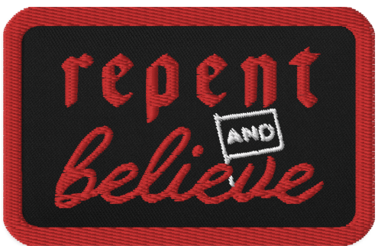
3. Repent- change your mind about your sin- (breaking God’s laws) & your view of God (Do you want God to change your life?) Transition to:
4. Believe (faith or trust)- that Jesus took the penalty for your sin on the cross & died in your place & rose from the dead. Do you believe he did this for you? He did!
(If you don’t want Jesus, He will give you what you want, eternally separated from God- (2Thessalonians 1:8-9)
Repeat 3 & 4 for clarity before you give the invitation to accept.
5. Accept/receive- Ask them if they are ready to accept Jesus as your Savior today.

Slide 10


A Clear Gospel
5 steps
1. Creator- for un-churched
Creation proves there is a creator,
Design proves there is a designer,
Laws prove there is a lawgiver.
2. Conviction
Hook- create interest
Eliminate false beliefs
Bad news methods – judgment
Gospel- good news Jesus paid it all
3. Repent- change your mind about your sins & God
4. Believe- what Jesus accomplished via the cross, death & resurrection
Repeat- repent & believe
5. Accept Jesus as your Savior
To Do: Study and practice “A Clear Gospel” - chose your conviction method…..
Pray God would send people your way

